Slide 1
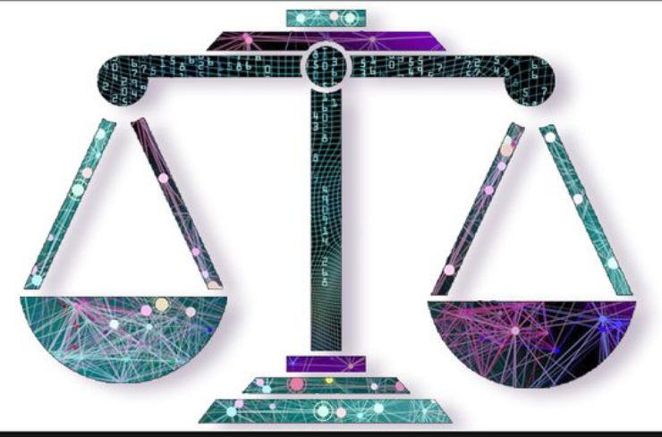
Fairness Classification using Machine Learning criminal recidivism – Black Lives Matter
By Nitin BHATI
MSc. Information Engineering and Computer Science
Date :01.07.2019

Slide 2


Agenda
Introduction
Problem statement
Motivation
Related work
COMPASS Score – Recidivism
CORE Concepts
Methodology
Results
ANALYSIS & LIMITATIONS
Conclusion

Slide 3
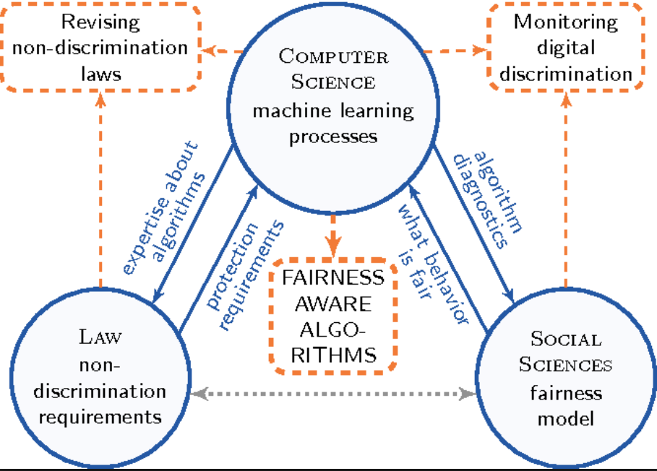
Introduction
In general, predicting the future using the historically labeled data as training set under supervised learning algorithms refers to as machine learning for classification. Designed algorithm uses labelled date to predict the future.
The use of protected attributes like race, color, gender etc. make these algorithms biased. Its a well-established fact that our society faces problems like discrimination based on gender, race or also because of the neighborhood we live.
In the US, courts are using COMPAS risk analysis tool to judge criminal behavior.

Slide 4
PROBLEM STATEMENT
Major algorithms are biased towards the social discrimination present in the society.
The classification algorithms provides an automated process to classify the data and therefore are free of human intervention. Such algorithms are designed favoring local ethnic groups and hence there is a need to formulate this problem of discrimination in technical terms so that we can work to remove biasness and ensure fairness.
GOAL : is to analyze a decision-making program and construct a proof of its fairness or unfairness. The focus is on equality of opportunity.
The prime focus of this research is to analyze the fairness of the algorithm based on the protected and sensitive attributes such as race, region (which comes under demographic parity). Aim here is to remove discrimination by adjusting the predictor values, target and outcome data of the protected group. The fairness and accuracy of the algorithm is eventually improved, which is the prime work done in the project.

Slide 5

Motivation
We are in the era of machine learning which is almost driving all the human decisions. For instance, employers are using machine learning to select the job applicants; in the US, courts are using COMPAS risk analysis tool to judge criminal behavior. Furthermore, such systems are responsible in accepting a loan application. When these applications are involved with people, they needed to be fairer. Recently one article released by ProPublica ‘MACINE BIAS’ which mentioned about COMPAS risk analysis tool setbacks and decision-making programs with biasness problem. Everyone should worry about biasness of such systems. If no one cares, we may be one of the persons who suffer from this.

Slide 6
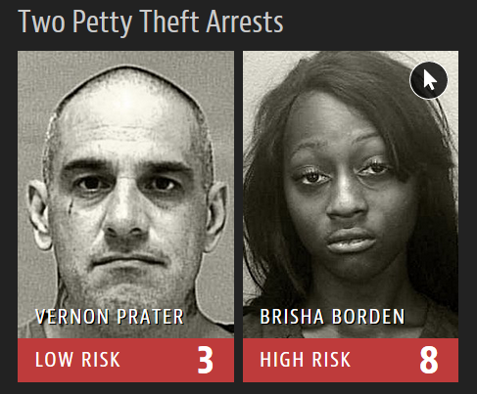
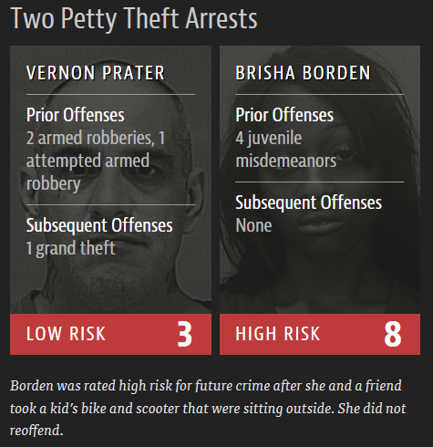
COMPAS Scores
https://www.propublica.org/article/ machine-bias-risk-assessments-in-criminal-sentencing

Slide 7

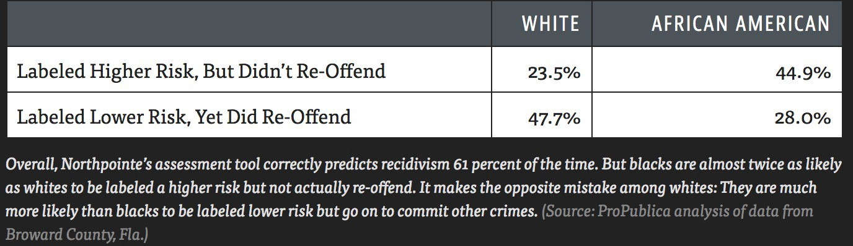

Criminal justice: recidivism algorithms (COMPAS) Score
https://www.propublica.org/article/ machine-bias-risk-assessments-in-criminal-sentencing

Slide 8
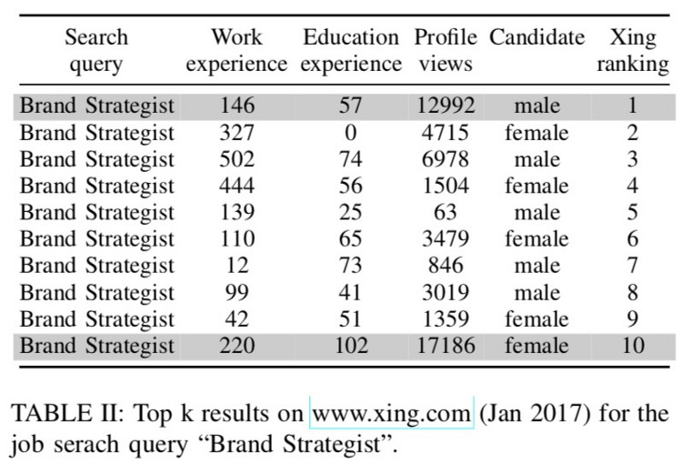
Related work
COMPAS (Correctional Offender Management Profiling for Alternative Sanctions)
Commercial algorithm used by judges and parole officers
For scoring criminal defendant’s likelihood of reoffending (recidivism).
Online Banking Loan Applications
University/College Admissions
Job Applications
Automatic job Selection
Rating the Job applicant

Slide 9
CORE Concepts
Equalized ODDS:
The predictor and the protected attribute (race, gender, etc.) should be independent, conditional on the outcome.
This technique requires that the percentage of people who were recidivist or non-recidivist and who gets qualified to be called non-recidivist are constant across groups.
EQUAL OPPORTUNITY:
Classifier should give similar results for defendants in both the groups.
This technique picks up a threshold for each group such that the fraction of recidivism people who qualify to be given a status of non-recidivism are same in both the group.

Slide 10
CORE Concepts
DEMOGRAPHIC PARITY
Individual who are like each other with respect to a task should be treated similarly without being influenced by the protected attributes.
Rather than classifying the groups based on protected and non protected attributes we should classify individuals who are comparable and then provide equal opportunity to all the individuals of this group.
Ensuring demographic parity does not ensure fairness.

Slide 11
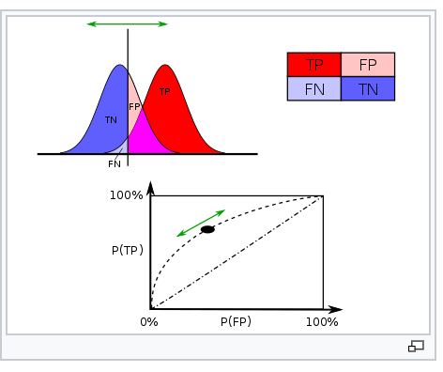
FALSE POSITIVE AND TRUE POSITIVE RATES:
A true positive is an outcome where the model correctly predicts the positive class.
A false positive is an outcome where the model incorrectly predicts the positive class.
Here the ROC (Receiver Operator Characteristic) captures the false positive rate and true positive rate at different thresholds and agree between different values of a protected attribute( RACE in this case).

Slide 12
Methodology
Equality of opportunity in supervised learning
Derive a binary predictor or real value scores which are discriminatory in nature.
In the post processing a non discriminatory predictor is obtained rather than changing the training process.
The predictor gives some values and a result is obtained by thresholding those values. Set of ten values(1-10) obtained from the predictor, thresholding is done to obtain if the criminal will again commit a crime or not.
Classifier is made to follow the notion of fairness as per the thresholds. Classified Data can be seen if it is biased towards a certain feature and if it is, we can apply our algorithm so that the threshold values follows our notion of fairness.

Slide 13
Predictor, Attribute and Outcome
A non discriminatory predictor is derived from a binary derived predictor.
The derived predictor derived from a random variables (scores) and the protected attribute (race) depends on protected binary attribute and binary predictor thus it only depends on four parameters (all possible combinations).
Parameters leading to points om convex hull.
Predictor should satisfy equalized odds and equal opportunity.
The data summarized by one dimensional scores and the decision is made based on these scores usually by thresholding these scores.
Need to change the thresholds to satisfy the terms, eventually trying to make a trade-off between FP and FN rates and thus increasing fairness of the algorithm

Slide 14
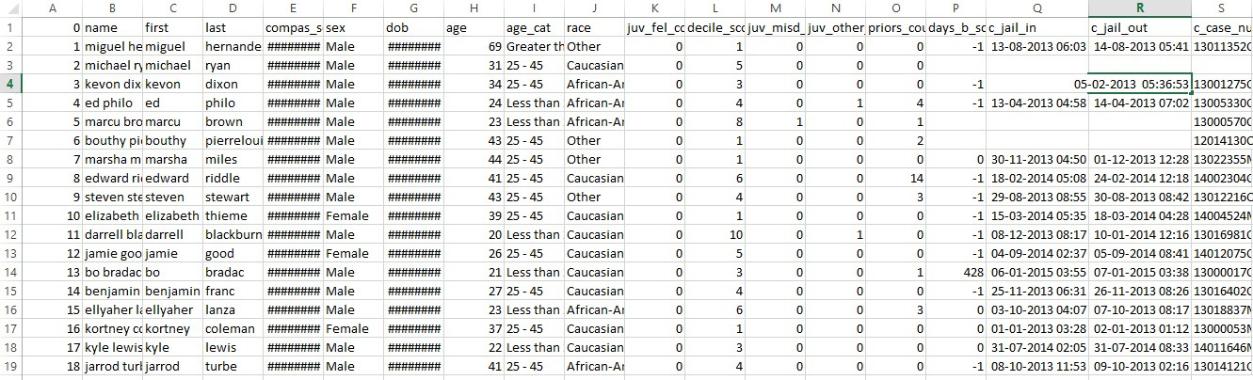
Dataset
Real criminal dataset, from Broward County Florida
Crime dataset fed into FLASK Application

Slide 15
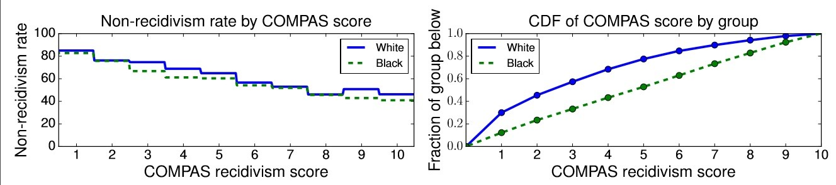
Results
COMPAS RECIDIVISM SCORE

Slide 16
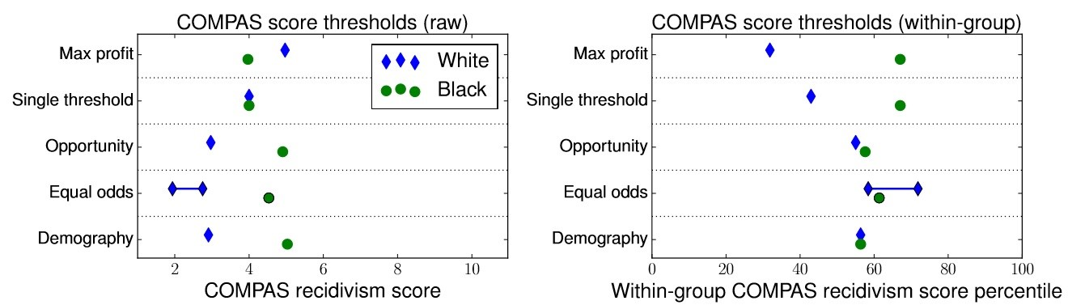

Slide 17
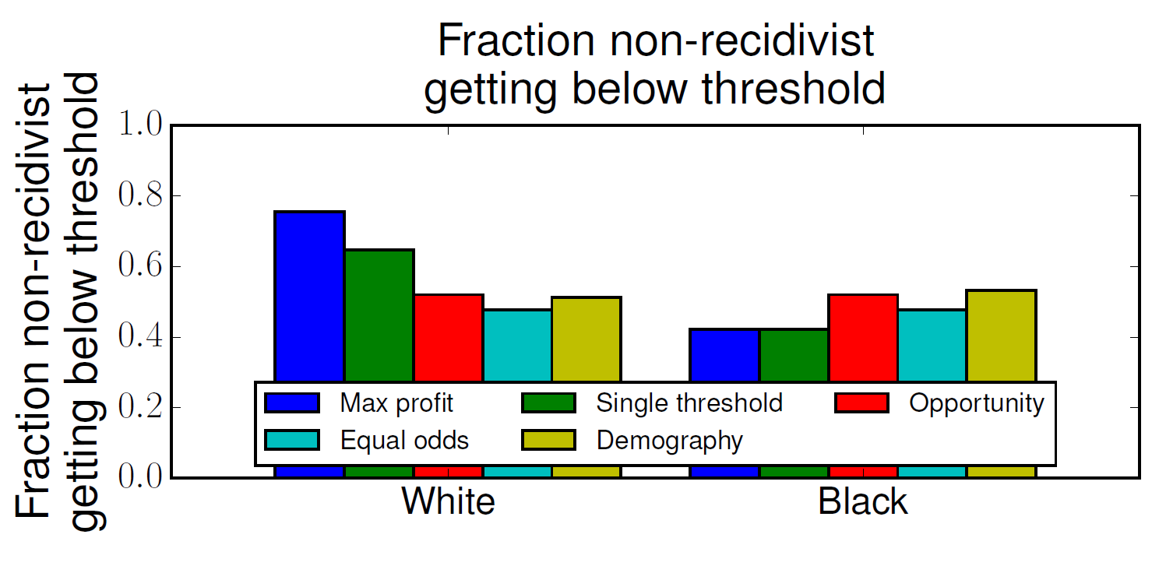

Slide 18
ANALYSIS & LIMITATIONS
The main goal of the research was to show how disparate impact can result from the use of a Recidivism tool.
Trade-off between accuracy and fairness usually exists.
Any two of the three group fairness definitions demographic parity, equalized odds, and predictive rate parity cannot be achieved at the same time.
It is not always possible to get labeled data and the measurement of target variables are not reliable and thus some scrutiny is required in defining and collecting a reliable target variable.
Slowness of application handling large volume of data.
Fairness libraries support for managing large data volume in generating efficient outcome.

Slide 19

CONCLUSION
The shortcomings of the demographic parity as a fairness notion are removed by the introduction of equal opportunity and equalized odds. It is also fully aligned with the concept of supervised learning that is to build a higher accuracy classifier.
Although supervised learning have been quite successful which shows that this requirement is met in many applications, but it is not always possible to get labeled data.
For achieving better results with equalized odds we need features that are directly focused on target variable and not related to the protected attribute.
There is a need to go through data processing steps before passing it to the system for calculating thresholds. This shows we need domain level scrutiny.

Slide 20
Bibliography
Aws albarghouthi, A. N. E. A. (2016). Fairness as a program property. In 3rd workshop on fairness, accountability and transparency in machine learning.
Cythian dwork, m. H. E. A. (2011). Fairness through awareness. In cornell university. [3] et al., C. D. (2003). Its not privacy and its not fair. In standford law review.
Et al., E. A. (2016a). Price of transparency in strategic machine learning. In 3rd workshop on fairness, accountability and transparency in machine learning.
Et al., M. H. (2016b). Equality of opportunity in supervised learning. In 3rd workshop on fairness, accountability and transparency in machine learning.
Julius adebayo, l. K. (2016). Iterative orthogonal feature projection for diagnosing bias in black box models. In 3rd workshop on fairness, accountability and transparency in machine learning.
Louizus, c. (2016). The variational fair autoencoder.

Slide 21
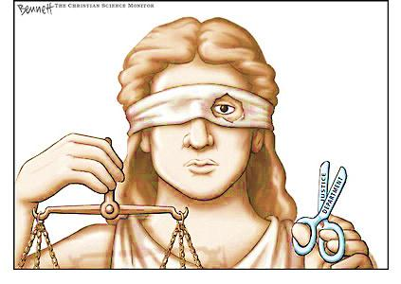
THANK YOU!
Questions?

